Slide 1


Reinforcement Learning Enhanced Ensemble for Predictive Issue Classification in Kubernetes Environments
Team:
Naidu Yaswanth Reddy
Srivatsal Parise
Prajwala Yadlapalli
TEAM CODEBLUE

Slide 2
Solution Overview
Multi-Model Architecture:
3 Specialized ML Models
RL Agent optimizes ensemble predictions
Why RL?
Learns complex interdependencies
Adapts to changing system behavior dynamically

Slide 3
Model Focus Areas:
Infra Issues → LightGBM
K8s Bottlenecks → XGBoost
Network Failures → DecisionTree
Model and RL Design
RL Setup:
Algorithm: Proximal Policy Optimization (PPO)
State Space: Model probability scores
Rewards: +1 for correct, -1 for wrong

Slide 4
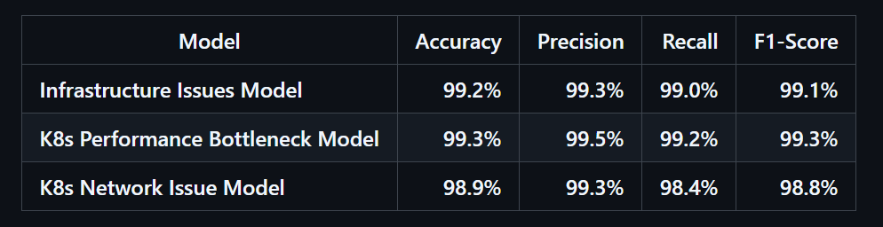
Results & Early RL Behavior
Early RL Progress:
Mean Accuracy: ~49.5% (Early training)
RL is learning which model to trust in ambiguous scenarios.

Slide 5
RL Edge:
Dynamic weight assignment to models
Context-aware decisions beyond static ensembles
RL Edge & Future Enhancements
Phase 2:
RAG Model for context-aware predictions
Remediation Engine to auto-suggest fixes
Use RLlib and Gymnasium for scalability

Slide 6
THANK YOU

